Slide 1
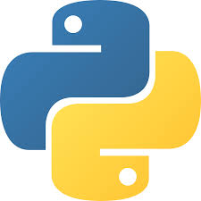

Automated Python Docstring Generator
Milestone 2
Submitted by- Team C
Tinamoni Sonowal Ranjan Kumar Verma
Karla Mounika Pavan Sai
Repository URL
https://github.com/rvranjan01/ai_docstring_generator.git

Slide 2

Content
Introduction
Problem Statement
Objectives
System Architecture
Technology used
Backend Deep Dive
Frontend Overview
Frontend UI
Output/Results
Potential future Enhancement
Conclusion

Slide 3
Introduction
This project is a full-stack application that automatically generates Google-style docstring for python code. It processes uploaded .py files, uses AI models to analyze functions, and inserts accurate docstrings back into the code. The solution saves developer time, ensures consistent documentation , improves code readability, and showcases the use of modern technologies like FastAPI, AST parsing, and AI language models.

Slide 4
Problem Statement
Time-Consuming Documentation
Inconsistent and Low-Quality Docstrings
Poor Maintainability
Developer Productivity Loss

Slide 5
Objectives
Automate Google-style docstring generation
Automate google style docstring generation
Reduce Manual documentation effort
Ensure consistent documentation format
Improve code readability and understanding

Slide 6
System Architecture
ai_docstring_generator/
├backend/ # FastAPI server and AI logic
│ ├ai_engine.py # Gemini/OpenAI integration & prompt logic
│ ├ main.py # FastAPI application with upload endpoint
│ ├ parser.py # AST-based Python parser
│ └─ requirements.txt
├ frontend/ # Simple HTML/JS UI for file upload
│ ├ index.html
│ ├ script.js
│ └ style.css
├ func.py # sample arithmetic script (demo purposes)
├ hi.py # empty placeholder
├ test.txt # miscellaneous/test data
└ README.md # this documentation

Slide 7
Technology Used
Backend:
- Python 3.10+ : Core language.
- FastAPI : Modern, fast (high-performance) web framework for building APIs.
- Uvicorn : ASGI server for running FastAPI.
- AST module : Python's built-in Abstract Syntax Tree module for code parsing.
- Hugging Face / OpenAI API : For AI-powered docstring generation.
- Python-dotenv : For managing environment variables (API keys).
Frontend:
- HTML5 : Structure of the web page.
- CSS3 : Styling.
- JavaScript (ES6+) : Client-side logic for file upload, API calls, and UI updates.

Slide 8
Backend Deep Dive
main.py (FastAPI Application) :
- Defines the /upload endpoint.
parser.py (AST-based Python Parser) :
- Uses Python's ast module to analyze the uploaded code.
ai_engine.py (AI Integration) :
- Connects to OpenAI API.
code_inserter.py (Docstring Insertion) :
- Takes the original code and generated docstrings.

Slide 9
Frontend Overview-
Index.html :
Provide a simple drag and drop or click to upload interface for python file.
Script.js :
Handles user interactions (file selection, frag-and- drop).
Style.css :
Basic styling for a clean and functional user interface.

Slide 10
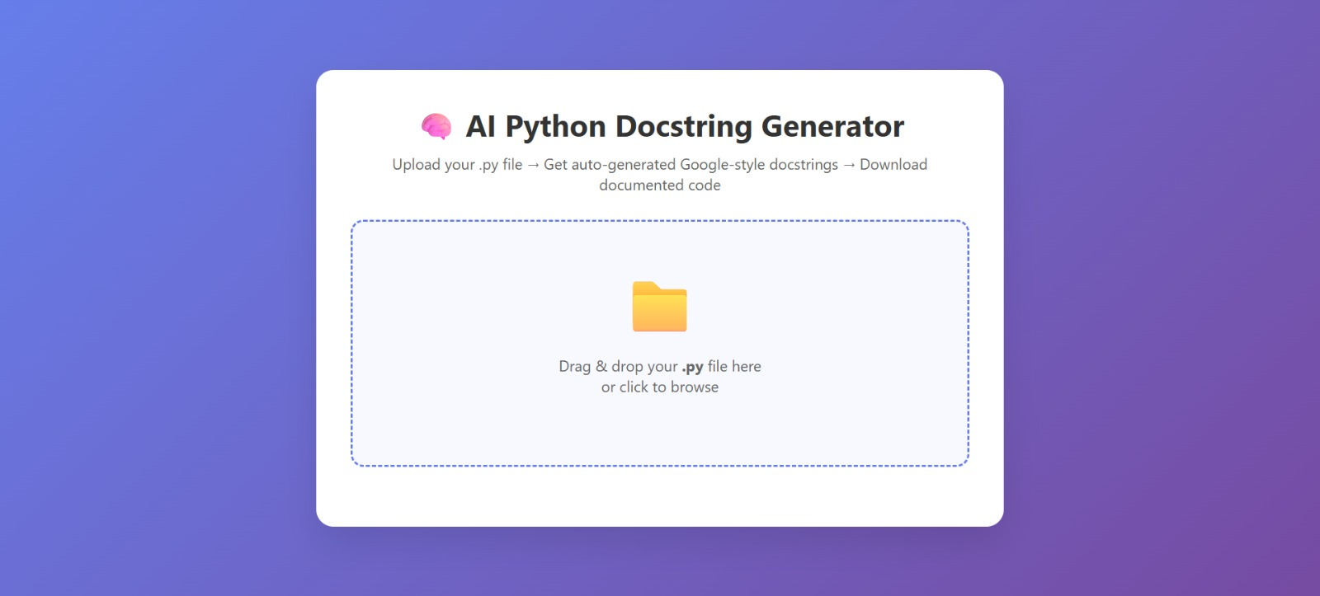
Frontend UI-

Slide 11
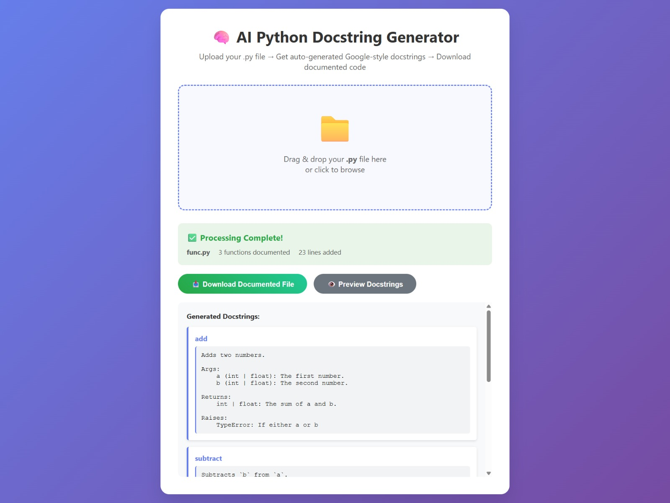
Output-

Slide 12
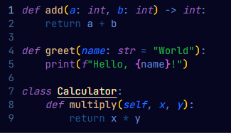
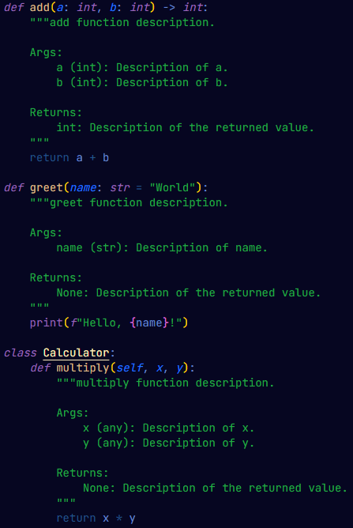
Results-
Before | After

Slide 13
Future Enhancements-
Support multiple AI/LLM models.
Enable different docstring styles(Google, numpy, etc).
Improve AI error handling and feedback
Add automatic type-hint inference.
Enhance frontend with code editor and syntax highlighting.
Implement testing and CI/CD pipeline.

Slide 14
Conclusion-
Automates Python docstrings with AI, saving developer time.
Enforces Google-style consistency for clearer, maintainable code.
Preserves code logic while improving readability and onboarding.

Slide 15
Thank You

